Slide 1
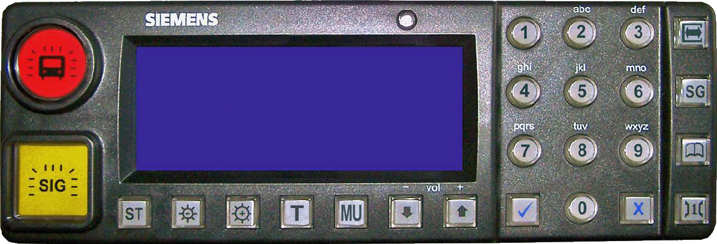

GSM-R Control
Status: Connected
Turn On
umm
GSM-R GB 1Z99
Messages
Settings
Reset GSM-R
Emergency Group Call

Slide 2
Settings
Game Settings
Blocked Registrations
Phone Book List
Main Menu

